Slide 1
Survey on the Ellipsoid & Navigation Technology for Decision Support
  Mary Erickson
  NOAA Tech Summit
  November 3, 2010
  Office of Coast Survey
  Center for Operational Oceanographic Products & Services
  National Geodetic Survey
NOS
Notes:
How surveying on the ellipsoid adds to decision support - shoreline change and bathymetric change can more easily be tracked by comparing over the years in ellipsoidal space versus a datum that can vary over the years.
Validation of VDatum can improve ability to combine land and sea elevation data for storm surge/inundation and SLR.
Maybe put in an IOCM slide and include backscatter supporting fisheries needs - this can hopefully be acquired concurrently while surveying on the ellipsoid.
Maybe put something in about the chart of the future that can use hydrodynamic modeling for planning and transit since your talk title is Survey on the Ellipsoid & NAVIGATION TECHNOLOGY for Decision Support.
I think some of the slides could drop out such as the next steps one at the end.

Slide 2
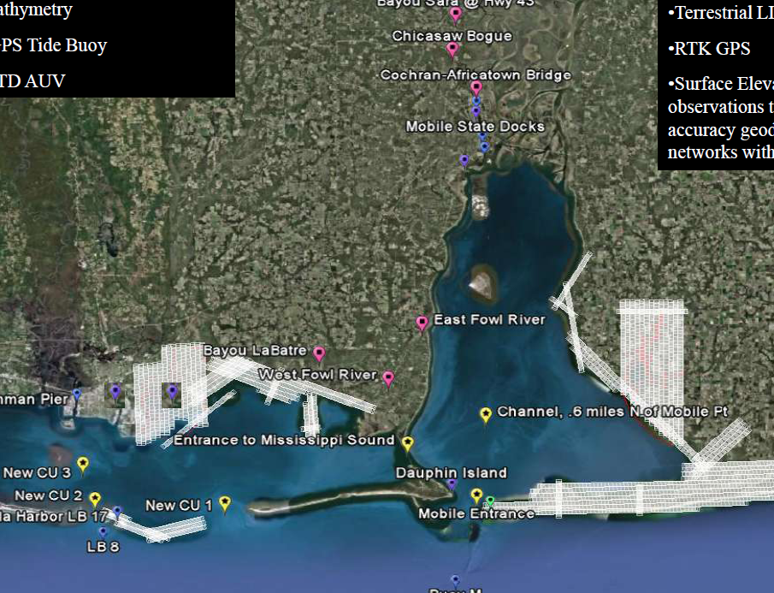
Mobile Bay Collaboration Project
OCS Provides:
Hydrodynamic Model
Bathymetry
GPS Tide Buoy
CTD AUV
Nautical Charts
CO-OPS Provides:
Water levels
Currents
Meteorological Info
NGS Provides:
Aerial LIDAR surveys
Terrestrial LIDAR surveys
RTK GPS
Surface elevation table observations

Slide 3
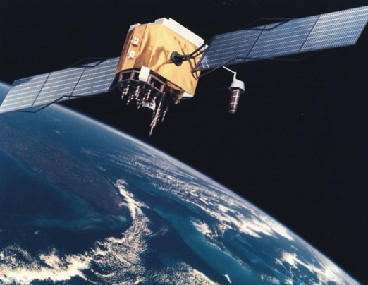
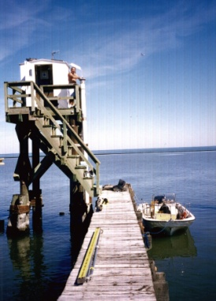
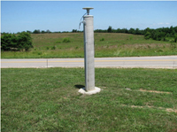
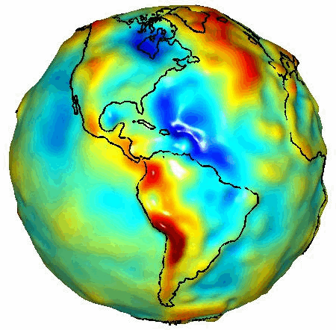
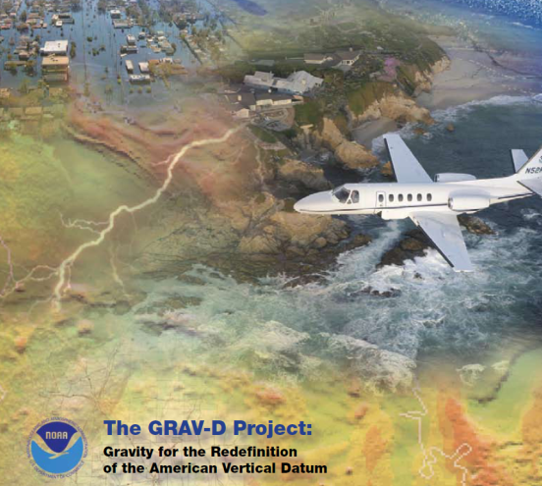
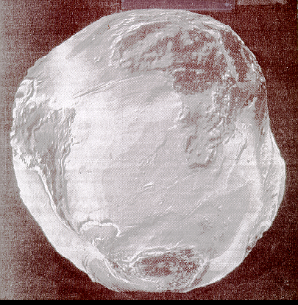
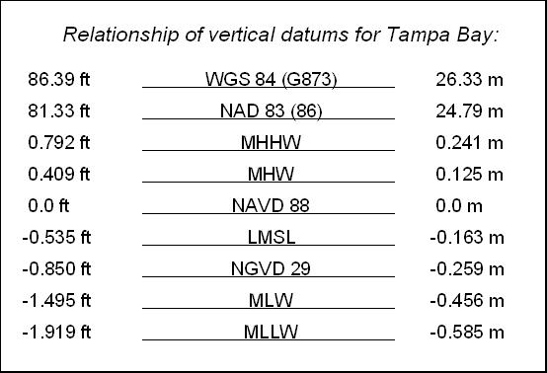
Datums
Vertical
Water Levels
Positioning - Integration
GPS
Horizontal
CORS
NADCON
Vdatum, GRAV-D
Notes:
Improve ability to position ourselves, whether it’s a vessel, airplane, train
Chart of the Future relies on accurate and consistent positioning
R&D to improve accuracy of geoid and transformations between the various datums.
Acquire accurate and adequate base data (gravity, water levels, GPS observations)
Supplying tools to allow easy manipulation for the user.
Developing methods to validate results and determine uncertainly of transformations
Use of VDatum to allow hydrographic surveying efficiencies

Slide 4
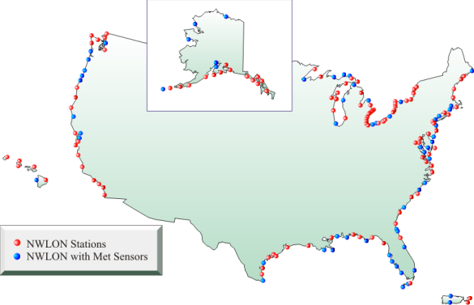
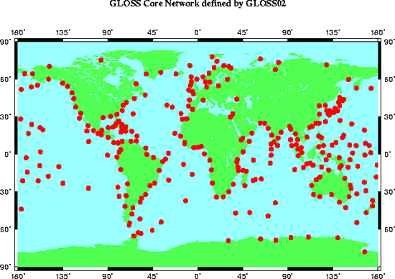
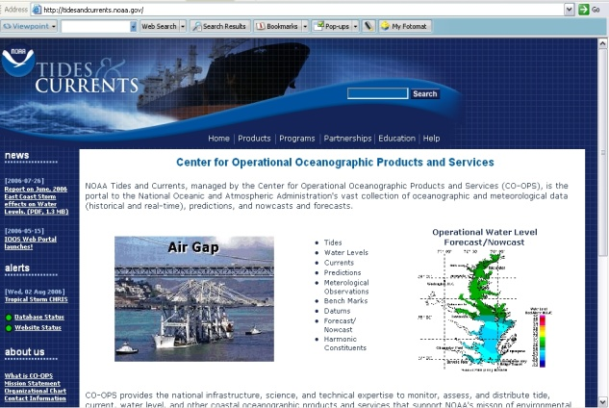
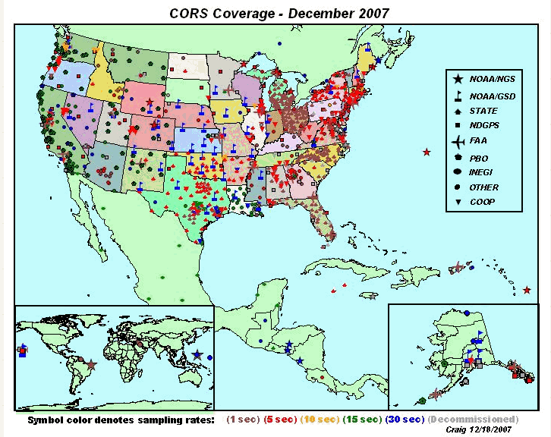
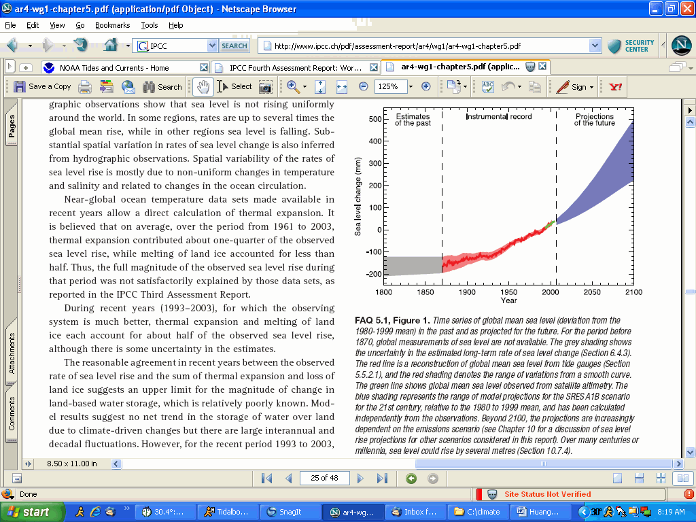
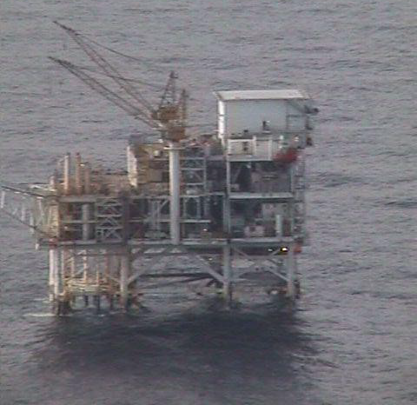
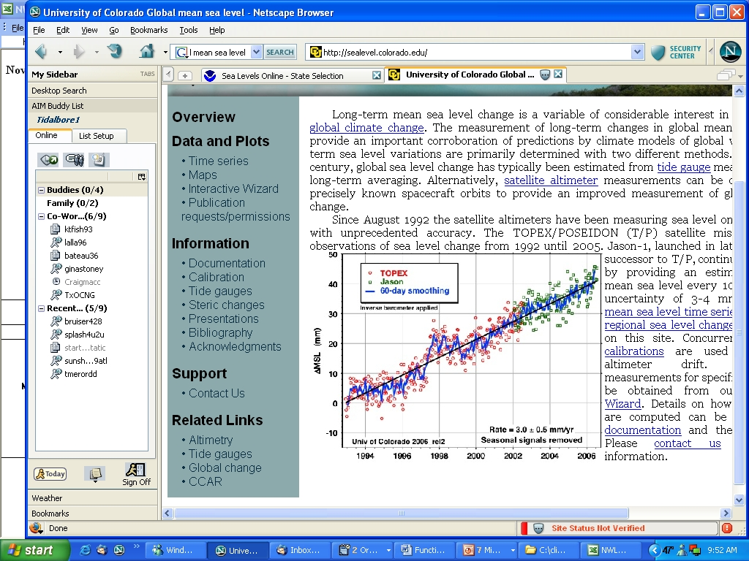
National Water Level Observation Network (NWLON)
Global Sea Level Network
Water Level &
Instrumental Records for Climate Change
210 Stations
CO-OPS
National Geodetic Service
Co-Location
tidesandcurrents.noaa.gov
Global Sea Level Rise Estimates
Continuously Operating
Reference Stations (CORS)
http://www.ngs.noaa.gov/CORS/
NWLON Platform Harvest Station is used
for Satellite Altimetry Calibration
Notes:
The NOS Center for Operational Oceanographic Products & Services has 210 permanent water level and meteorological stations located throughout the U.S. and island territories. Long term water level data, geodetic, and satellite measurements contribute to the global sea level estimates for climate change monitoring. The NWLON provides data streams and value added data in many ways to try to help in answering question regarding global sea level trends and in trying to determine if there is any acceleration on global SLR. The COES provide precise estimates of vertical land motion at each tide gauge, thus allowing for more precise estimates of actual sea level variability and how they contribute to the global variability.

Slide 5
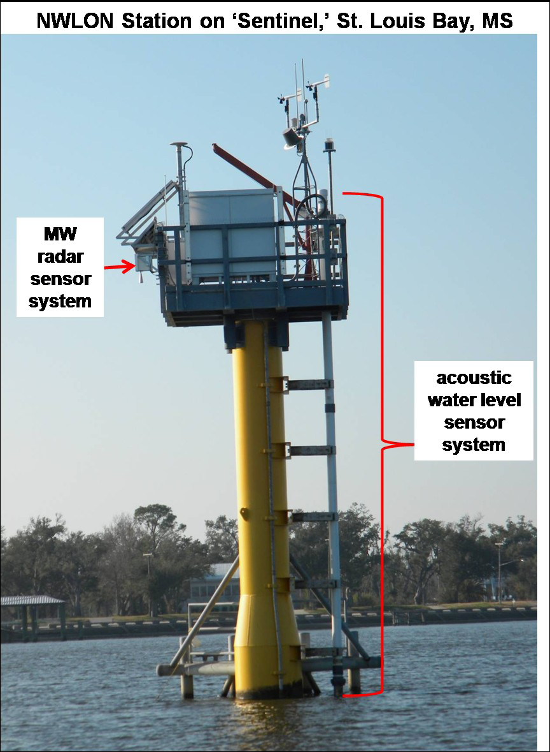
New Technology Infusion for
Water Level Measurement
NOAA is replacing acoustic
water level sensor technology with
microwave (MW) sensor technology
A multi-year laboratory and
field test and evaluation is underway
MW water level configurations are
less expensive to maintain as there
are no ‘in-water’ components
Simultaneous data sets from old and
new systems will be obtained to
ensure data and vertical datum
reference continuity

Slide 6
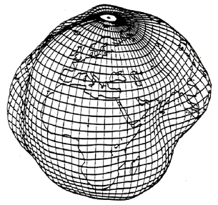
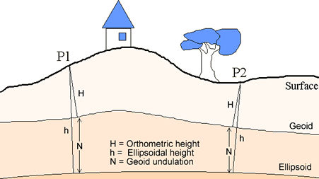
Geodesy & GPS for
Science and Technology
Geodesy: The science associated with accurate measurements and representation of the Earth.
Why: The Earth is dynamic, has an irregular surface, and is challenging to measure and model physical processes.
Processes: To study static and dynamic processes such as crustal motion, tides, sea level change, positions and the geoid, geodesists use sophisticated techniques (GPS, SLR, Airborne Gravimetry) to define latitude, longitude, orthometric, geoidal, and ellipsoid heights as well as establishing global and national coordinate systems.
Notes:
Geodesy is the science associated with accurate measurements and representation
of the Earth. The Earth has many dynamic processes and we use GPS to help
scientists garner the information we need to make sound decisions.

Slide 7
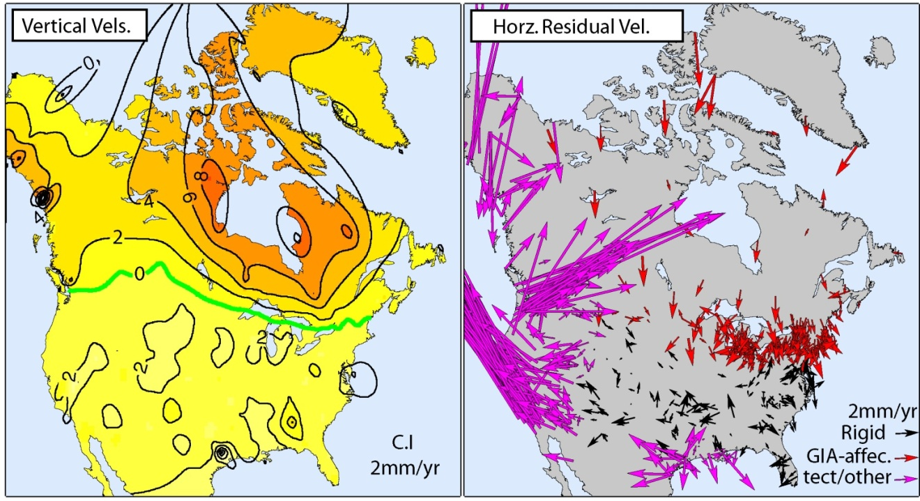
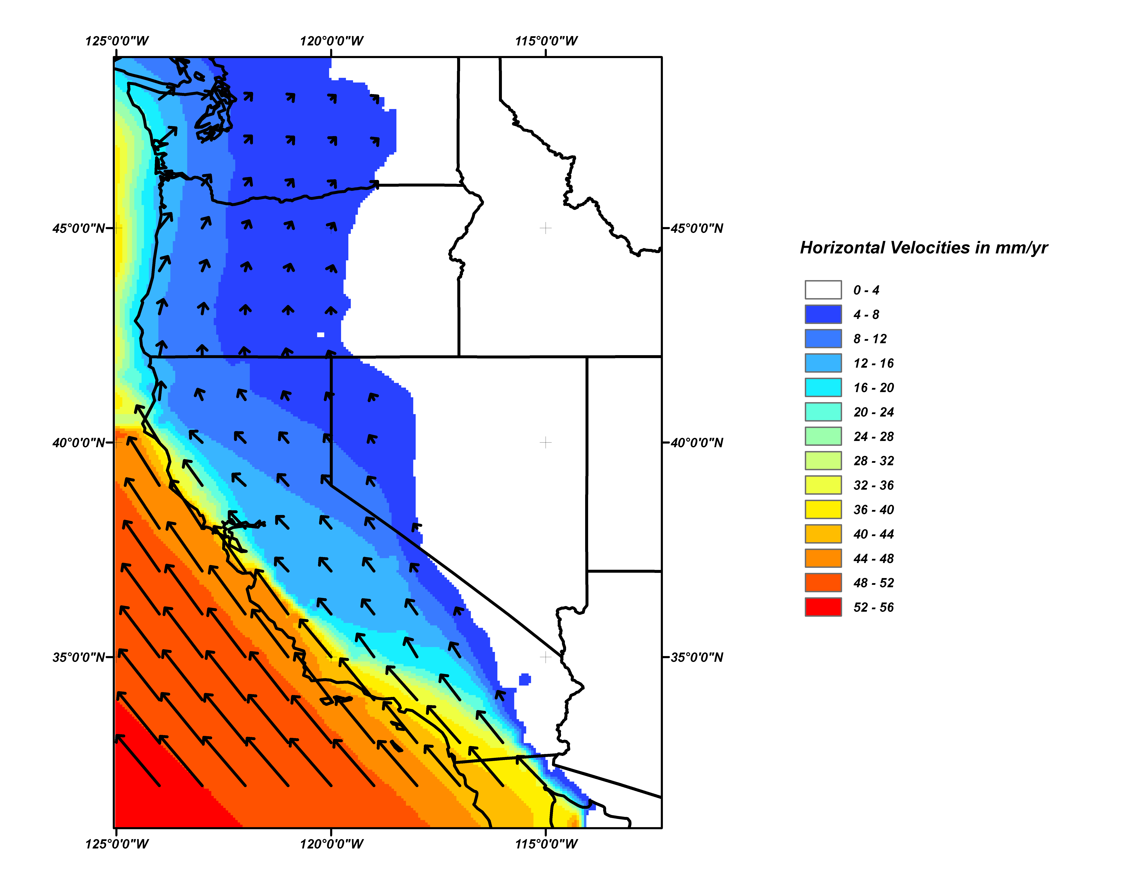
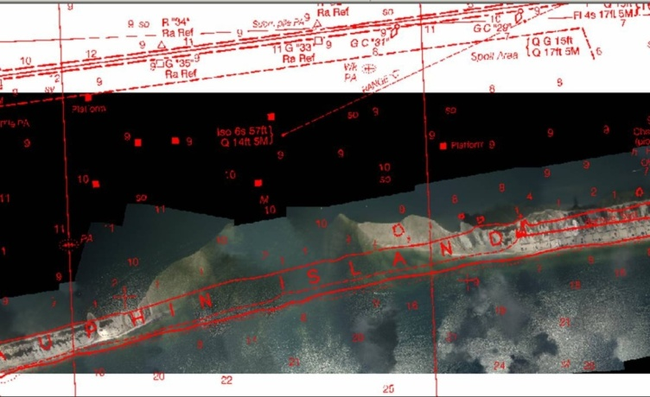
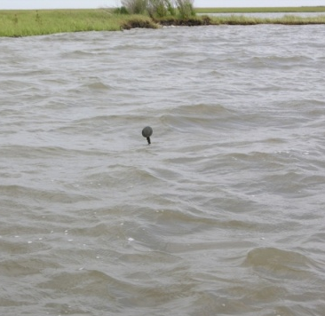
Accurate Positioning
for Many Applications
Monitoring: Points (control) established on any coordinate system often move with time. Long term monitoring with GPS provides the necessary data for accurate decision making and forecasting.
Benchmark set at 0.2m (1980)
Notes:
One of the most notable processes of the earth is associated with plate tectonics.
Because the crustal plates move, the points (control) established to define a reference
frame also move over time. The figure on the left illustrates the magnitude of the horizontal
velocity for the pacific plate (affects west coast). Velocity is large just offshore and decreases
as you move eastward. The center and top right figures also illustrate that a number of local
and regional effects can cause significant changes to ground control.

Slide 8
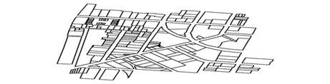
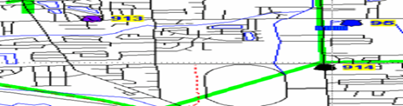
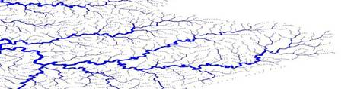
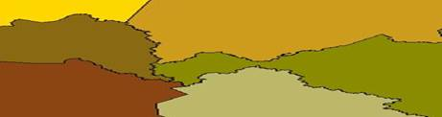
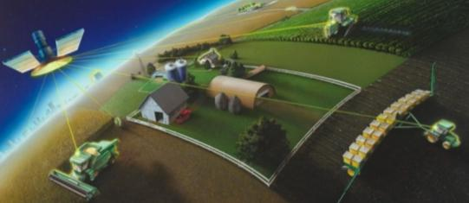
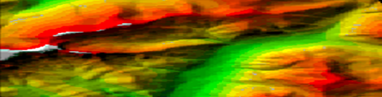
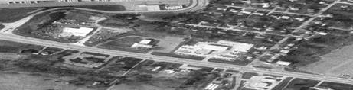
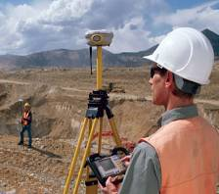

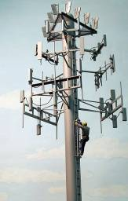
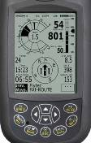



NGS Provides the
Geospatial Infrastructure
GPS Tools: For assessing social, economic and environmental impacts
Land Ownership
Transportation
Surface Waters
Precision Agriculture
Boundaries
Elevation
Geodetic Control
Fishing &
Boating
Aviation
Surveying
Shipping
Personal
Navigation
TeleComm
Power
Notes:
NGS provides the geospatial infrastructure for numerous segments of society. The critical
component is to have accurate geodetic control by which all the other "layers" are tied to.
GPS is used to guide farm tractors for accurate harvesting as well as for spraying (less waste).
Economic indicators are directly tied to the amount of goods and services which are brought into
the country. Shipping and transportation use GPS technology to maximize loads etc, cell phone
towers use GPS for timing etc.

Slide 9
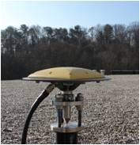
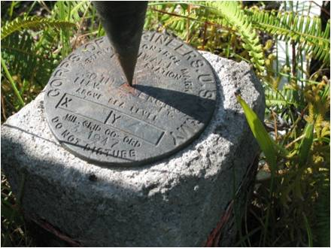
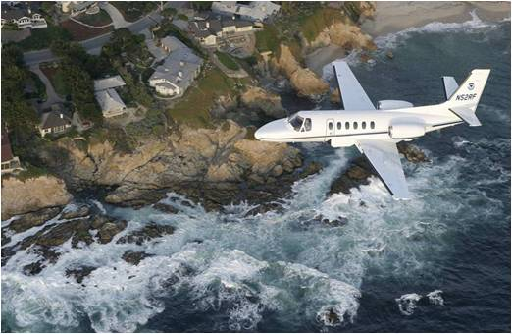
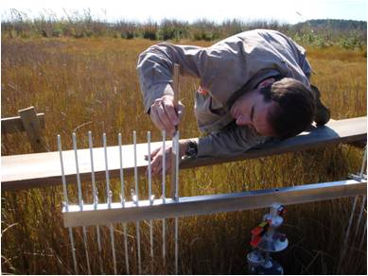
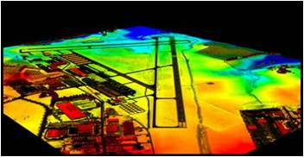
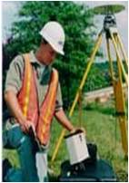
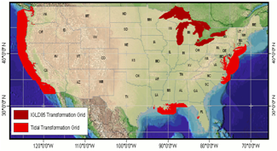
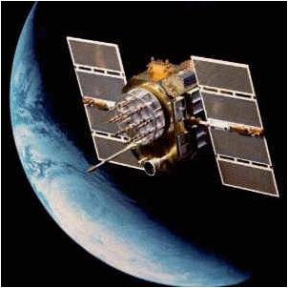
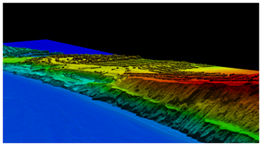
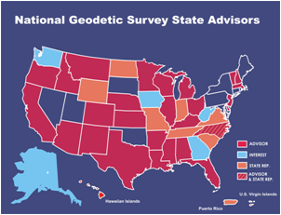
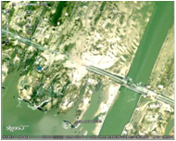
Technological Revolution from GPS
Continuous Evolution of the NSRS
CORS
Height Modernization
GRAV-D
COASTAL
Cutting Edge Tools & Applications
Airport Surveys
OPUS
VDatum
GNSS Research
Shoreline Mapping
State Advisor Program
Emergency Response Imagery
Notes:
GPS has revolutionized the way many things are done. With GPS, NGS is able to continuously
monitor and refine the NSRS and a number of components which support the NSRS infrastructure.
GPS has also allowed for the development of a number of specialized tools which simplify the way
data is processed and information is shared for decision making. A number of high-visibility program
use many tools developed by NOS so products are made available much faster.

Slide 10

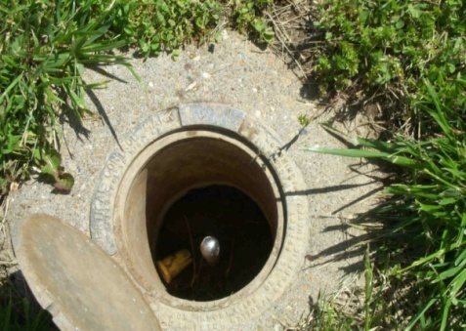
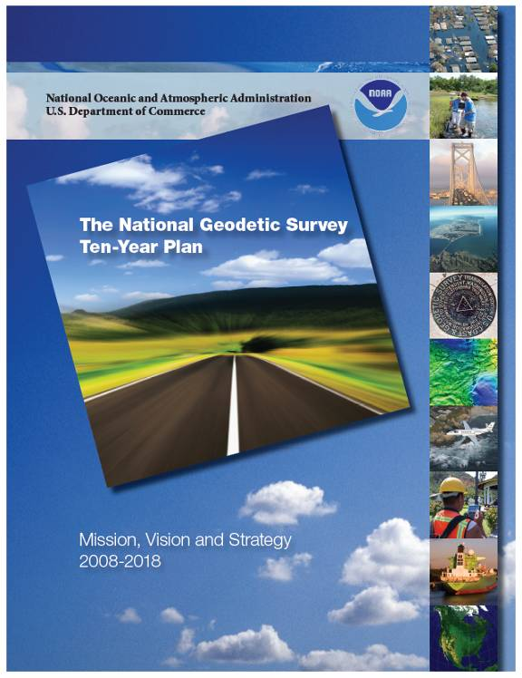
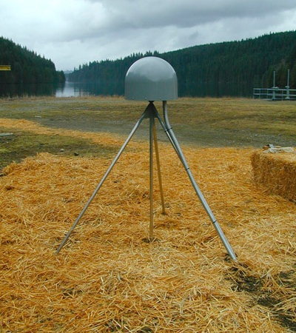
Advancing to the Future
Modernizing the Datums (Geometric & Geopotential)
Geometric – Evolve GPS Products & Tools
Geopotential – Replace NAVD88 w/ Geoid-based Datum
Modernizing Heights - Accurate Heights from GPS
Dam / Levee Safety
Evacuation Planning
Hazard Mitigation
Flood Plane Mapping
Subsidence Monitoring
Water Levels
Ten Year Plan of the National Geodetic Survey
Notes:
NGS is devoted to providing the best products and services and therefore the agency is always
looking to the future and setting new goals to meet. What do we need to do to support NOAA
objectives as well as those of our constituents? The ten year plan provides insight to where NGS
is heading and what we should expect.

Slide 11
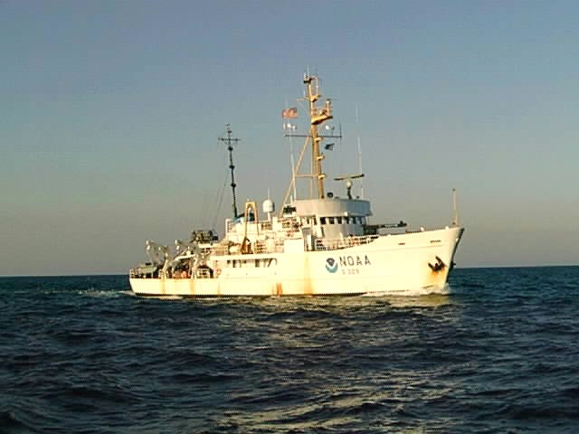
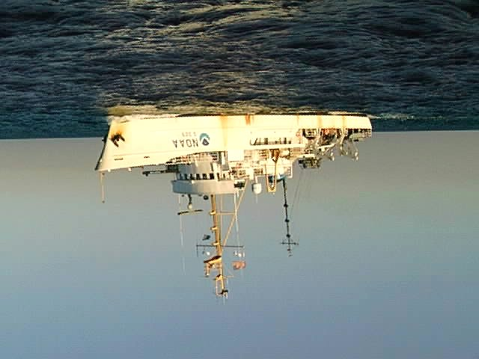

Surveying on the Ellipsoid
Advantages
  Decouple tide measurements from survey
  Reduce vertical uncertainty from heave, dynamic draft
  Improve data utility
    Direct geometric tie of surveys to the wider geospatial infrastructure
    Stable Geometric Datum Reference - World standard
Ellipsoid
MEASURED
KNOWN
using
VDatum
KNOWN
MLLW
COMPUTED
(depth MLLW)
MEASURED
Notes:
Decouple: Sea level datums are local and change
Reduce Uncertainty: ERS is hydro reckoned to the geometric ellipsoid from GNSS positioning, as opposed to the in situ water level
Inline with National Spatial Reference System infrastructure (NGS 10-year plan of Grav-D geopotential datum will have a direct geometric tie as well)

Slide 12
Ellipsoidally Referenced Surveys
Challenges
  Transformation to MLLW
    Geometric, orthometric , and tidal relationships must be known
    Models exist: VDatum, CRD, etc
    Alaska, Pacific Islands, etc. are an issue
  Shore Support effort not eliminated in all cases
    Effort equivalent to tide gauges?
    GPS base stations or CORS
  Post-processing of position data
Notes:
current NAVD-88 hybrid geoid, future Grav-D geoid, topography of the sea surface (TSS), and tidal datums
Shore Support: vertical datum recovery; again, may happen in advance of hydro survey--efficient divide-and-concur
Post-processing of data: well-defined datum transformations route to user-desired (supported) datums

Slide 13
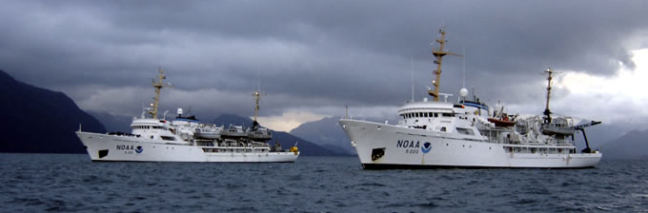
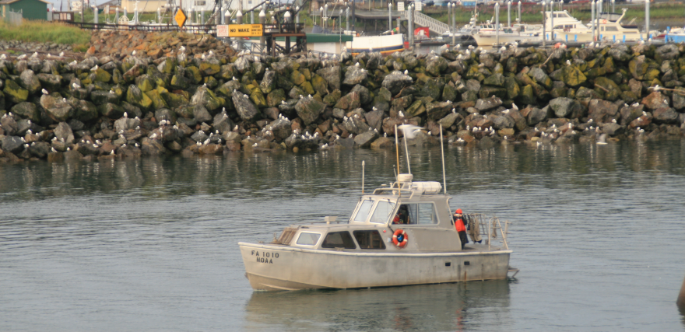
OCS ERS Operational Concepts
VDatum and CORS
  e.g., Chesapeake Bay, Long Island Sound
Small Local Area
  Port and Harbor Surveys
  Tidally simple regimes
  Single transformation value
Alternate validations of transformation methods
  Establishment of GPS base stations, GPS water level buoys
  Post-survey determination of datum transformation
Real-time vs. Post-processed
Notes:
single trans. value should really be simplified on-demand VDatum, where it makes sense in lieu of waiting for full VDatum coverage in the overall general locality

Slide 14









VDatum: A Vertical Datum Transformation Tool
Bathy/Topo
Digital Elevation Model
Geoid
Model
Tidal
Model
Ellipsoid
Model
USGS
Topography
NOAA
Bathymetry
VDatum
( Vertical Datum Transform Tool )
National
Bathymetric
Database
Kinematic GPS
vertically-referenced
Hydrographic Surveys
Consistently defined Shoreline from LIDAR data
GIS users in the Coastal Community
Resolve NOAA-USGS shoreline
inconsistencies
Marine Boundaries
and Legal Issues
MHW Shoreline Produced from LIDAR
User-friendly utilization of DEM with new hi-res data in a GIS environment
October 31, 2007
USGS Topo Sheet
NOAA Shoreline
Notes:
14

Slide 15


VDatum Update
Now offering maximum cumulative uncertainty (standard deviation) for all available regions
Evaluated at the water level stations only
Still need to define uncertainty away from stations (for example, in center of bay)

Slide 16

GPS Water Level Buoy
Value
  Information away from the shore/water level gauges
    Local mean sea level to ellipsoid difference
    Tidal datum information (e.g., MHW, MLLW)
  Can be used to:
    Validate vertical datum transformation tool (VDatum)
    Validate the use of VDatum for hydrographic surveying
    Supplement existing water level data
Notes:
Mobile tertiary tide gauge, not dependent upon physical attachment to terra firma"

Slide 17



GPS Water Level Buoy
Consists of
  Dual-frequency GPS Receiver
  Tilt Sensor
  Data Logger/Storage
  Telemetry (Iridium, Wi-Fi)
  Batteries
Testing underway
  Four 30-day deployments
  Various locations/conditions
    High-wave environment: Duck, NC
    Low-wave environment: DC or Norfolk
    High-range environment: Eastport, ME
    Low-range environment: Mobile Bay
  Comparisons to nearby NWLON water level gauges
Notes:
comparison to nearby Primary NWLON gauges, tied to NTDE

Slide 18


Slide 19

NOAA Ship Rainier Project Area
OPR-N395-RA-09, Puget Sound
(VDatum, CORS)

Slide 20


Difference Surface – ERS vs. TCARI
σ = 0.361m
orange/red = 0.5 m
green / blue < 0.25m
Notes:
Working across three platforms – differences averaged for all three:
Mean: -.051m, std: .051, min: -.036, max: .085

Slide 21
Next Steps for 2011+
Conduct ERS where feasible
  Criteria developed for candidate ERS hydrographic surveys
Continued VDatum Development and Validation
  GPS Water Level Buoys
  Vessel-based observations
Continued acquisition of hardware and software

